Slide 1
Operations Management Suite – Migrating and Protect Workloads
Peggy Pinelo Merchan

Slide 2


Operations Management Suite Capabilities
Log analytics
Backup & Recovery
IT Automation
Security & Compliance
Effortless log collection
Integrated fast search and queries with custom dashboard
Integrated cloud backup
Seamless disaster recovery and workload migration
Hybrid runbook worker
Graphical workbook authoring and automation DSC
Malware assessment
Security posture and system update assessment
With OMS capabilities customers can…
Spot problems fast
Protect data easily
Automate tasks quick
Recognize threat early
extending System Center capabilities, as an all-in-one management solution!
Notes:
The idea behind oms is to give you a complement management and security solution, independent on which cloud you are working on.
Log Analytics is the foundation which provides the overview in single pane, with automation you can take action and orchestrate DR.
As you can see Backup and Recovery is part of the suite and provides flexibility of where you can run a workload and protect it.

Slide 3
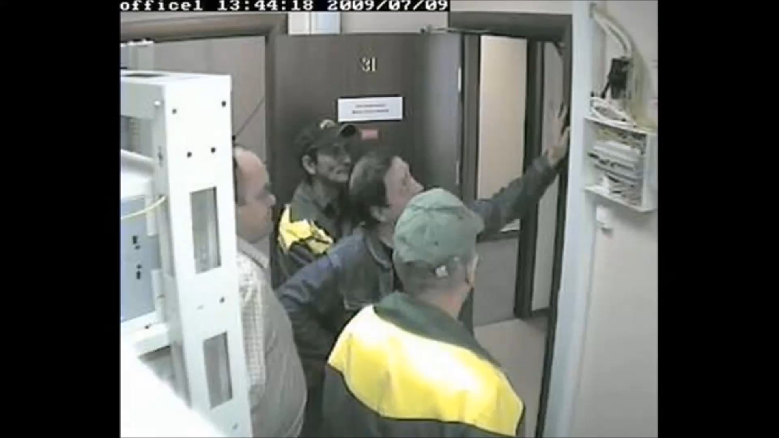
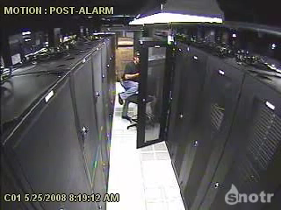
Notes:
No matter how perfect redundant your infrastructure is, failure is always an option.

Slide 4
Failures come in many flavors. It's not optional.
Notes:
`
Software Bugs
Hardware Failure
Human Mistakes – best intensions; judgement & skill; 50%
Power Outages
Can be working for years and BOOM unexpected failure

Slide 5
Common Challenges We hear from our customers
‘I am unable to deliver the services my business requires’
‘My infrastructure is extremely complex and difficult to manage’
‘I don’t have the capital budget required to keep my infrastructure up-to-date’
Notes:
Shorter RPO is more infra and complexity
Frequent testing is hard to maintain with traditional infrastructure. Test every year or after a major change.
Automation is key to limit errors.

Slide 6
How can technology help?
Protect your data
Scale as you need, pay as you go
Automate
Azure is the only hyper-scale hybrid cloud vendor to provide end-to-end data protection and business continuity solutions
Notes:
Azure is a fully hybrid platform and offers various BCDR & HA solutions
HA Application, Network, Storage. Think Traffic Manager, Availability sets etc.

Slide 7
Building Highly Available and resilient apps on Azure
Fault scope
 | Hardware (Compute/Disk) | Datacenter (Power/Network) | Region
IaaS (Stateless) Web Server with SQL PaaS backend | Availability Sets | Availability Zones (AZ) | Azure Site Recovery
IaaS (Stateful) Custom Applications (all IaaS) Dynamics AX (Azure SaaS offering) | Azure Site Recovery | Azure Site Recovery | Azure Site Recovery
PaaS Azure Cloud Service Azure Service Fabric managed application | Cloud Service | Availability Zone | Geo Redundant Storage (GRS) Or Active-Active
Application
Pattern
Notes:
Redsign your application or DR stafeful via ASR
Backup is always required for data retention. Without backup no DR.

Slide 8
Enabling Technology Azure Site Recovery and Azure Backup
Datacenter
Availability on Demand
Azure Site Recovery
Azure Backup
Notes:
Azure can help in the vorm of recovery services. Azure can do a lot more also to provide high availablre applications but this session is about recovery services.
Recovery services
Need both ASR and Backup.

Slide 9


Replicate: on-prem or Azure
Secure Hyper-V, VMware, and physical servers
VM Replication
RTO/RPO Near Zero
Heterogynous
Secure
Monitoring
Orchestration
Migrate
Microsoft Azure Site Recovery
Microsoft Azure Site Recovery
Communication & Replication
Replication channel
Recovery site
Primary site
Any OS
Windows
Linux
Notes:
VM replication, hardware agnostic
hybrid
It’s fast easy and simpel.
Easy test and orchestration
No compute, vms are turned off
Application consistent, VM Group consistent

Slide 10
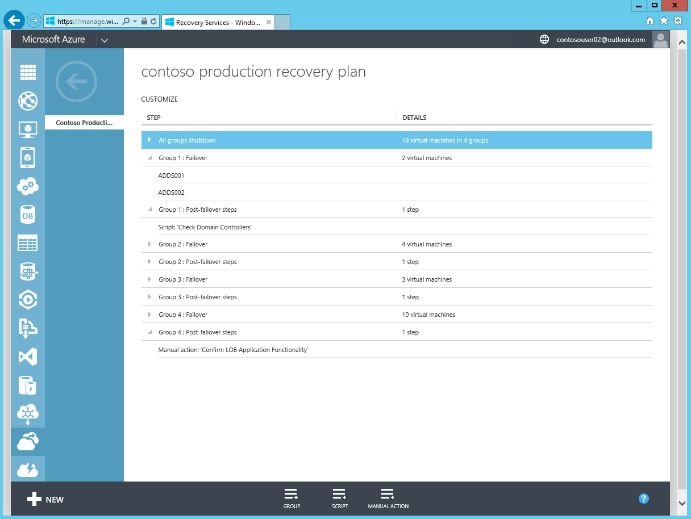
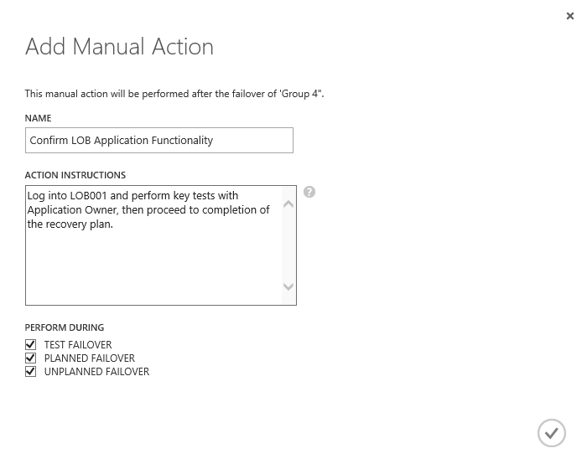
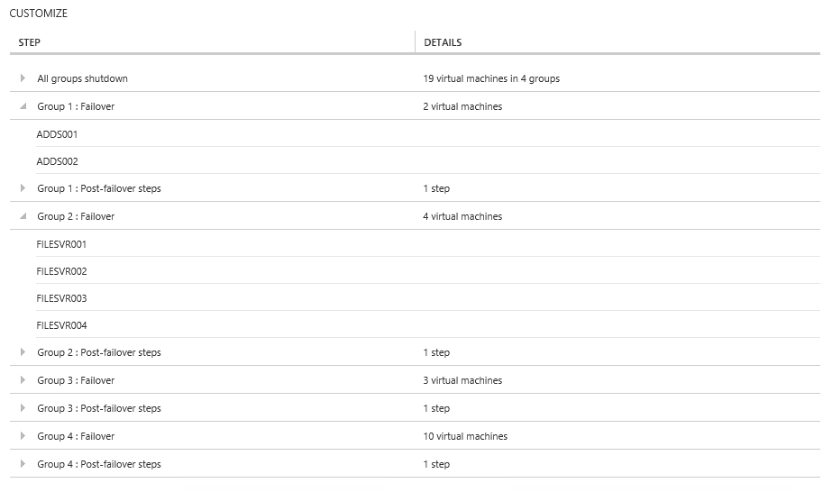
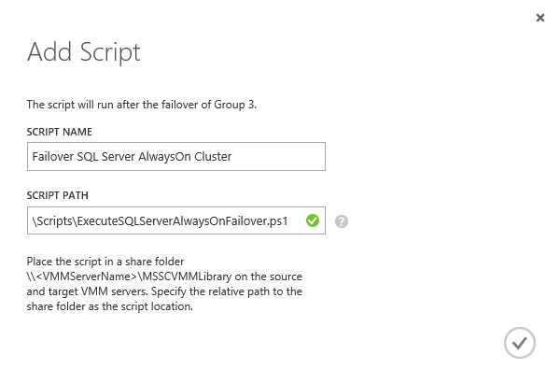
Orchestrate: Recovery Plan
Orchestrated steps for recovery: Recovery plans help automate the orderly recovery in the event of a site outage at the primary datacenter.
.
Script integration: Scripts can be added, to run before or after a specific group in a recovery plan
Manual actions: Manual actions can also be added, to run before or after a selected group.
Notes:
Most important value add = test and orchestrate

Slide 11

Use Cases
Planned failover
Unplanned failover
Testing and staging
Migration
Execute a failover in a controlled manner for testing or for controlled business need.
Process focused orchestrated disaster recovery.
Mirror production deployments to Azure.
Use the DR copy as a testing/staging environment.
Replicate to Azure, validate the deployment, application behaviors, etc. Disconnect from on-premises.
Notes:
Planned failover for Hyper-V Ony, VMWare does near sync.

Slide 12


VMware and Physical Servers
443 (HTTPS)
PS/CS Server
Azure Site Recovery
9443 (HTTPS)
443 (HTTPS)
Microsoft Azure
Source: VMware VMs & Physical Servers
Process Server
Used for caching, compression, and encryption
Configuration Server
Used for centralized management
Mobility Service Captures all data writes from memory
Notes:
Agent based replication (because we can’t install on VMWare hypervisor level).
For failback:
You must have site-to-site VPN for failback
If failing back windows workloads, you do not need an MT on-prem (it is already provided)
If failing back Linux workload, you must manually build a LinuX VM on-prem
For failback (Linux or Windows) you could technically use the PS on-prem but then you need ExpressRoute for efficient operation. However, setting up the PS on Azure during failback is relatively easy. It just takes time.

Slide 13
VMware to Azure Replication
Protected VM
Initial replication reads
Upload changes
Cache
Apply to target VHDs
ASR Server
Track data changes
Process Server
Cache
Upload changes
During initial replication, initial copy of data on protected virtual machine is replicated to Azure Storage
During differential replication, data changes that are tracked since enable protection are replicated to Azure Storage
Resync is same as initial replication

Slide 14
Hyper-V With or without System Center
System Center
443 (HTTPS)
Azure Site Recovery
Hyper-V Server
443 (HTTPS)
Microsoft Azure
Source: Hyper-V VMs
Microsoft Azure Recovery Services Agent
Replicates data to Azure
Microsoft Azure Site Recovery DRA
Centralized Management
Notes:
Host based.
No need for VPN or extra infra for failback.
Cons: limitations in what can be replicated since it’s host level based.

Slide 15
Hyper-V to Azure Replication
Hyper-V Host
Initial replication reads
Upload changes
Cache
Upload changes
Cache
Apply to target VHDs
ASR Server
Track data changes
Initial replication creates a snapshot of the disk
While initial replication is in progress, ASR tracks changes and writes them to a HRL file
Changes to the disk get written to a AVHDX file
Depending on the churn and the time taken for initial replication
HRL file could grow up to 50% of the original VHD size
AVHDX file could also grow up to 50% of the original VHD size
Up to 100% of extra space is required during initial replication

Slide 16
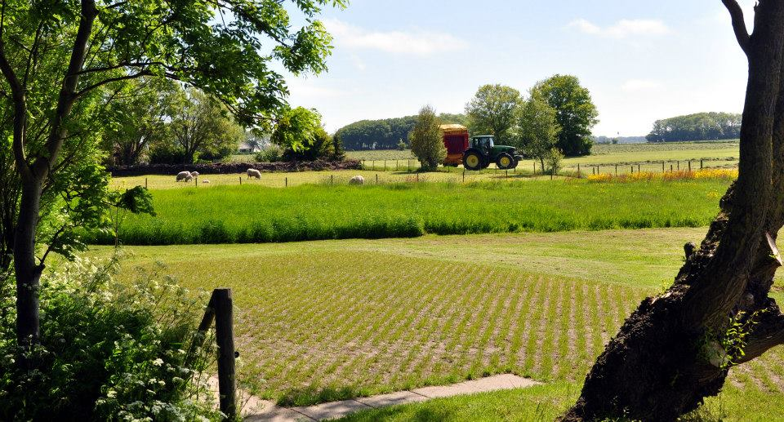










The World’s first 100% cloud municipality
The Dutch City of Hollands Kroon embraces a radical digital transformation to reinvent its workplace and service delivery to citizens
Objectives
By harnessing the cloud, Hollands Kroon wanted to empower employees to do their best work wherever they want, while gaining new insights into the city’s digital data
Tactics
In order to reimagine their workplace, Hollands Kroon built their digital infrastructure in the Microsoft Cloud, including Azure, Office 365, Dynamics Online, Power BI, Enterprise Mobility Suite
Results
Employee morale is up, absences and costs are down
The city is leveraging digitized information to improve decision making
A more mobile work force delivers better services to its citizens
“With Microsoft solutions, we can extract actionable information out of our data that just was not possible before. We’ve come a long way already, but there are still many great adventures ahead to make our city even smarter and make our citizen services even better.”
—Arthur Cremers, Director for the Municipality of Hollands Kroon
Notes:
Migrated with ASR, Using Veeam for Backup and NetApp Private Storage
Key points:
Customer profile: Hollands Kroon is a municipality located in a large farming region in northern Netherlands, and its scenery is a snapshot of iconic Dutch images–flowers, windmills, dikes and beautiful coastland. The city was formed in 2012 by the merger of four smaller cities that comprise a total of 22 different villages. http://www.hollandskroon.nl/
Business goal: Dutch city governments have been embracing the concept of the New World of Work—based on a 2005 white paper by Bill Gates—that empowers employees with the flexibility to choose how, where, and when they work. But Hollands Kroon took this digital transformation to a radical new level, becoming the world’s first 100% cloud municipality.
Tactics: By harnessing the cloud, Hollands Kroon wanted to empower employees to do their best work wherever they want, while gaining new insights into the city’s digital data. In order to reimagine their workplace, Hollands Kroon built their digital infrastructure in the Microsoft Cloud, including Azure, Office 365, Dynamics CRM Online, Power BI, and Enterprise Mobility Suite.
Results: This digital transformation has created happier employees and citizens in Hollands Kroon. Employee morale is up, absences and costs are down. The city is leveraging digitized information to improve decision making and a more mobile work force delivers better services to its citizens. Hollands Kroon is now a smarter and more innovative city and a perfect example of the New World of Work.
Further information: https://customers.microsoft.com/Pages/CustomerStory.aspx?recid=29118

Slide 17
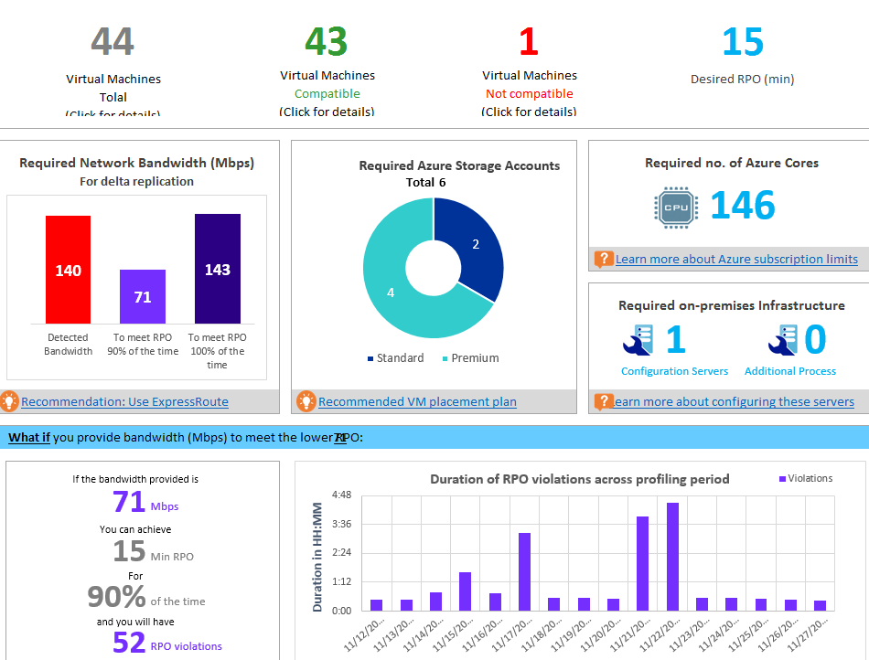
Deployment Learnings
https://aka.ms/asr-deployment-planner-doc
Capacity Planning
Network bandwidth
Process/Config Servers
Churn
Azure Storage
On Prem Storage
Replication & Failover VM IOPs
Compute Capacity – More details
Azure IAAS Limitations
Disk < 1023 GB
VMs with 64 disks (64 TB) and leverage SQL Always-ON for DB workloads
UEFI
For Hyper-V VMs ASR does Gen-2 to Gen-1 conversion at failover
Premium Storage with Hyper-V? → available soon

Slide 18
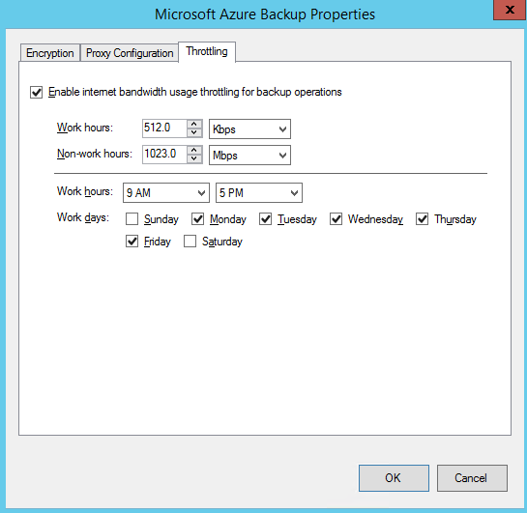
Deployment Learnings
Replication Traffic
ASR in built compression
ExpressRoute – More details
Riverbed – More details
Throttling
First class experience with MARS agent – More details
Support Matrix
Hyper-V – Hyper-V guest supported same in Azure
vSphere 6.0, 5.5, or 5.1 with latest updates

Slide 19
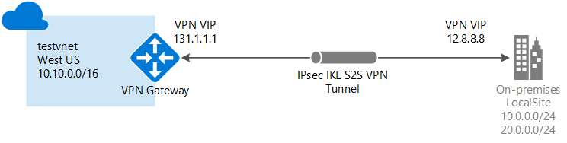
Deployment Learnings
Networking
Remap IP. we cannot stretch subnets if failing over to Azure as that is a Layer 2
Retain IP vs. Change IP – More details
Public IP
ASR + Azure Traffic Manager - More details
Firewall, IPS HTTPS
When the IP addresses on the recovery site are different, a DNS record update is needed
NOT RECOMMENDED: When the IP address is retained on the recovery site:
The entire subnet has to be failed over
VPN connections need to be created to the recovery site
Routes have to be changed to indicate that the subnet has moved to the recovery site

Slide 20
Recently added
Azure Site Recovery
New simplified experience on the portal.
Premium storage, Exclude disk support for VMware to Azure.
GA of Encryption at rest with ASR. (With Azure managed keys)
ASR HUB support for Migration.
CSP Program
Region availability : Azure US Government cloud, India South, Canada
Scout 8.0.1 Update 3 and Update 4
Update3
RHEL/CentOS 6.7
Update4
vCenter/vSphere 6.0
RHEL/CentOS 7.x
RHEL/CentOS6.8
Extended Linux support
Red Hat Enterprise Linux 7.1, Red Hat Enterprise Linux 7.2, CentOS 7.0, CentOS 7.1, CentOS 7.2
Enhanced Graphical Capacity Planner
Notes:
Managed disks: klant hoeft geen storage accounts en limieten meer te managen. Fault domains for VMs en storage.
Manage disk is zichtbaar als 1 logische disk.

Slide 21
Roadmap
Azure Site Recovery
Vault upgrade from Classic portal to Recovery Services Vault in the new portal
Customize Resource Groups for failed over VM’s
Protection between Azure regions
Availability sets
Richer Operations Management Suite (OMS) integration
Azure Stack DR
Move Configuration Server to a PaaS-based micro-service
Azure Storage
Managed Disks
Larger Blobs
1TB -> 16 TB Disk Size
Notes:
Managed disks: klant hoeft geen storage accounts en limieten meer te managen. Fault domains for VMs en storage.
Manage disk is zichtbaar als 1 logische disk.

Slide 22
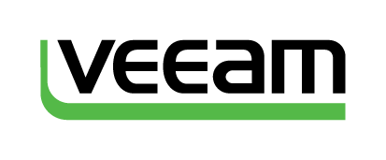

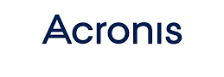

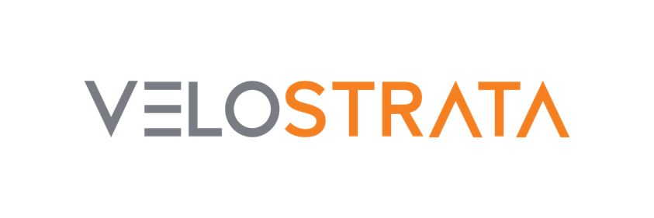



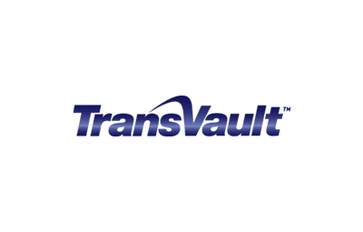
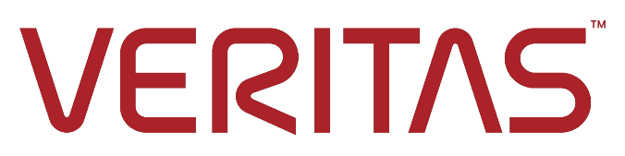













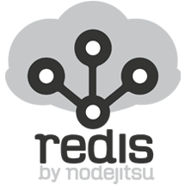
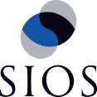





An ecosystem of support
Visit the Azure Marketplace to see them all!
BCDR in the Public Cloud
And more!

Slide 23
Selection Criteria
Crash consistent vs Application Consistent?
Consistency is key to recovering multi-tier applications
ASR supports multi-VM application-consistent replication.
VMs only or Physical?
Supported Hypervisor?
Supported Quest operating system?
Replication frequency?
Migration?
Orchestration/automation?
Security Encryption
Deployment. Agentless is nice but achieves crash constancy only.
Cloud? Multiple Cloud strategy?
Scale, Large deployments hundreds machines?

Slide 24
Azure as your Datacenter
Reduce the burden on IT and lower costs for your on-premises infrastructure
Control where you run apps and store data for a true hybrid experience
A scalable and reliable platform
Increase datacenter agility with on demand, near-limitless cloud scalability
EASY
FAST
AGILE

